Slide 1



Tilføj titel
Powerpoint 09. 05. 12

Slide 2

Overskrift
Duis autem vel eum iriure dolor in hendrerit in vulputate velit esse molestie consequat,

Slide 4
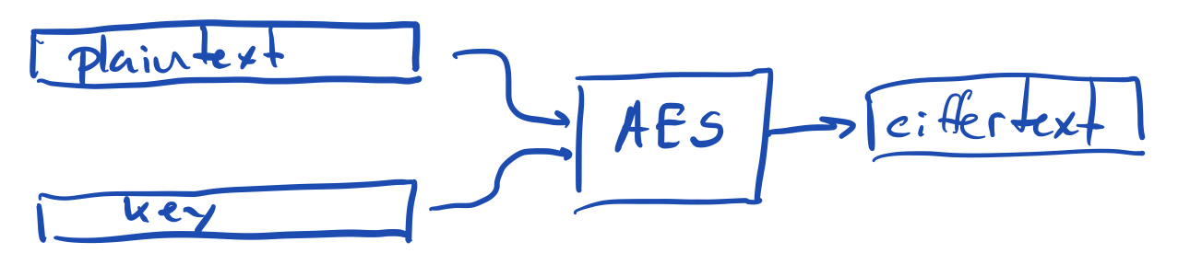
AES algorithm
The heart of the algorithm can “only” encrypt blocks which are 128, 196, or 256 bits long
(16, 24, or 32 bytes)
To make it work on real data, we need to
break the plain text into blocks and
encrypt each block.
There is one stupid way, and many good ways to do this

Slide 5
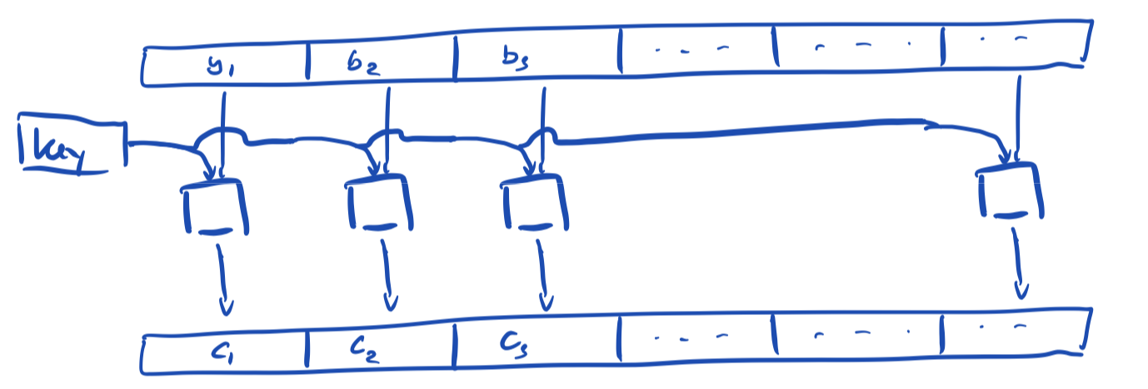
The stupid way - Electronic Codebook (ECB)
Do not encode each block using the same key

Slide 6
Cipher Block Chaining (CBC)
Bitwise
xor

Slide 7
Counter (CTR)
Secret & blockcount combined
using xor or other mechanism

Slide 8
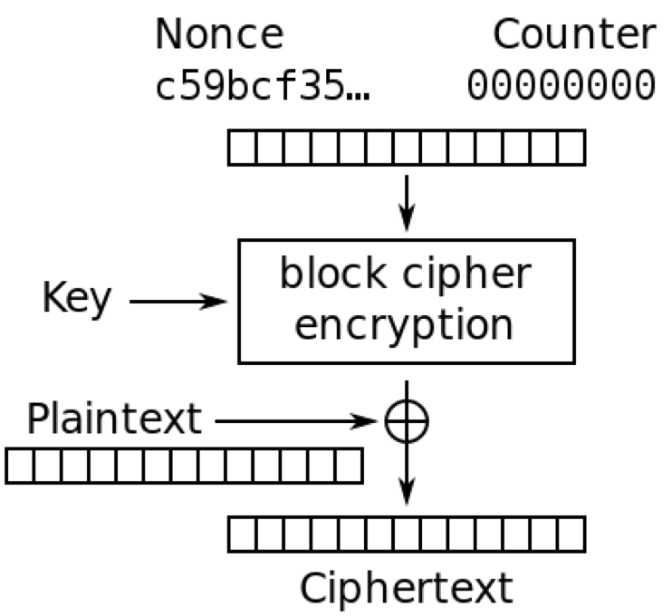
There are Java libraries for it all
And they are easy to use wrong.
There are three inputs
Plaintext
Key
Nonce (NumberOnce)

Slide 9
The Nonce
Is generated by a good random generator, saved to disk to be used later for decryption.
See sample code for this

Slide 10
The key
Has to be 128 (or 196 or 256) bits.
Is mostly generated from a password.
We will not go into password hashing now.
See the sample code for how to generate a 128 bit key from arbitrary password.

